Slide 1
UniBuddy
Deepak Ayyasamy
Tarun Siga
Sai Karthik Naladala

Slide 2

Offering Overview
Uni Buddy is an AI personal assistant services tailored specifically for students in the US.
This service encompasses a comprehensive approach to academic support, including study skills, time management, and emotional assistance.
Uni Buddy aims to bridge the gap between students and academic success by providing holistic guidance and personalized assistance to navigate through their educational journey effectively.

Slide 3
Why Uni Buddy?
According to a recent survey, there are 5,300 universities and colleges in US.
Students often find themselves lost in a maze of options, unsure of where to turn.

Slide 4

Why Uni Buddy?
UniBuddy provides personalized guidance tailored to your unique academic journey, ensuring success while navigating the maze of university options with confidence.

Slide 5
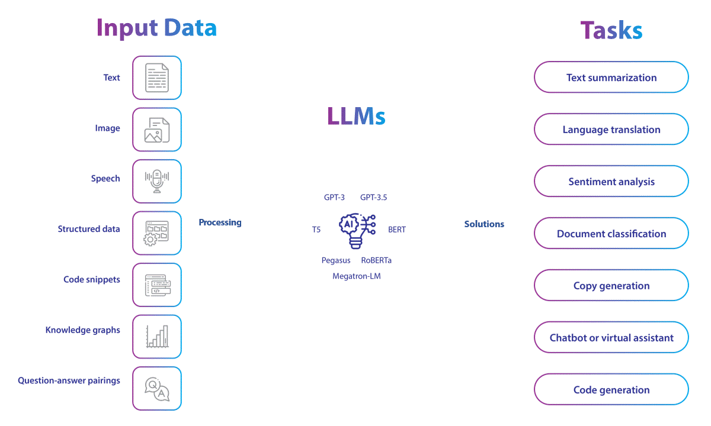
Why Uni Buddy?
. Uni Buddy harnesses the power of Natural Language Processing (NLP) and Large Language Models (LLMs) to provide unparalleled customization and attention to detail in user queries.

Slide 6

Revenue Generation
UniBuddy will generate revenue primarily through service subscriptions and packages tailored to students' needs in finding universities and devising career plans.
Tiered Packages:
Basic Plans: Provide access to essential tools such as college search tools, career assessments, and resume building resources.
Advanced Plans: Offer personalized university recommendations, career counseling sessions, and internship opportunities.

Slide 7





Value Proposition
Holistic guidance program to address academic success and emotional well-being, ensuring a student thrive in all aspects of life.
Tailored support to fit your schedule and needs
Committed to staying at the forefront of the industry, constantly innovating and improving services based on customer feedback
Strong relationships with customers, leading to long-term loyalty and satisfaction
Sustainable growth, navigating the challenges of the virtual personal assistant industry with excellence and customer satisfaction at the core.
Holistic Guidance
Personalized Assistance
Continuous Innovation
Building Relationships
Future Proof

Slide 8
Goals and Strategy
10,000
New Users
$50K Revenue
Target Revenue
Utilizing social media advertising (Facebook, Instagram, LinkedIn) and Google Ads to target students in the US.
Implementing retargeting strategies to engage with potential users who have shown interest but haven't converted yet.
Designing a referral program where existing users can refer their friends in exchange for discounts or credits on Uni Buddy services.
Sponsoring local events or student gatherings to increase brand visibility and engage directly with the target audience.

Slide 9
Capital/Revenue Allocation
Marketing and Brand Awareness
Social media marketing and online advertising to increase brand awareness and attract new customers. Targeted campaigns can effectively reach the desired audience and communicate the unique value proposition of Uni Buddy's services
Research and Development
30%
Aimed at continuous innovation. This involves developing new features or services based on emerging trends and customer feedback, ensuring Uni Buddy remains at the forefront of the virtual personal assistant industry
35%
15%
Customer Experience Enhancement
Market Research and Expansion
Invest in technology and infrastructure upgrades to ensure seamless service delivery and an intuitive user experience across all touchpoints.
Allocating funds towards comprehensive market research to understand the demand for virtual personal assistant services outside the US. This will help in identifying potential markets and tailoring services accordingly
20%

Slide 10

Milestones
January
March
April
INNOVATION
SETUP
LIVE
Complete technical setup, including the development and testing.
Conduct market research to understand international demand for virtual personal assistant services.
Officially launch Uni Buddy and go live.

Slide 11
Questions?

